Slide 1
KSO Programmability
TAC Interaction – SMS & WebEx Teams Workflow Automation
Alexander Valencia V.
Systems Engineer

Slide 2
Background
Carnival Corp is a Global Account that has 11 Brands and about 105 Ships.
Represent to Cisco about US$50MM in Bookings by year.
L1 and L2 support provided by Capgemini.
Customer statements:
Cisco doesn’t understand the support model required.
Every time that Capgemini opens a TAC Case, they spend a lot of time explaining to the TAC Engineer the Cruise Ship Network Architecture.
Every time that TAC assign a new Engineer to the case, the customer needs to explain everything since the beginning.
The customer required Continuous support from Cisco in the “Follow the Sun” Model and only one Cisco focal point for technical support
The Account Team invest around US$175K to have onboard an HTOM

Slide 3
Purpose of the Automation Workflow
The objective of the automation workflow is to notify proactively the Customer by SMS and through a Public WebEx Teams Space about any P1 and P2 TAC Cases. With this the Customer’s L3 Support Teams will have full visibility of the most important incidents. This WebEx Teams space will be managed by the HTOM.
Using the Public Space, the customer can request the following info:
Status of the Case
Description of the Case
Rise Severity of the Case
Who is the owner of the Case
Last updated date.
Escalation of the Case
Ask if there is any Bug
Ask for the status of a RMA
Get a link of the case

Slide 4
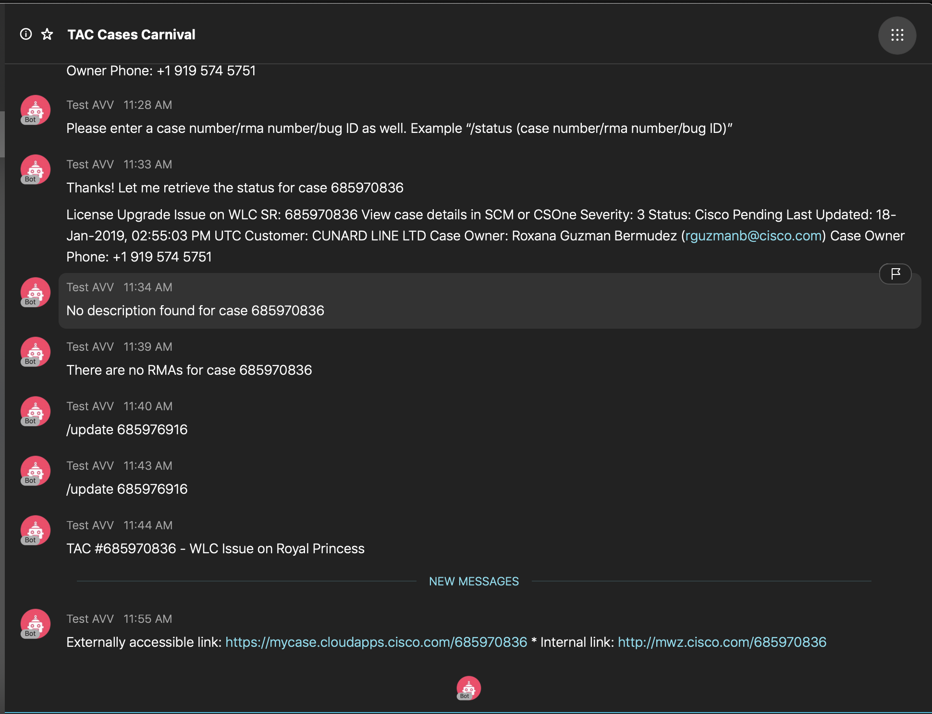
Workflow Diagram
Carnival Support Contracts
Cisco Foosball
WebEx Teams Space
WebEx Teams Bot
New TAC Case P1/P2
Cisco TAC
Support APIs
WebEx Teams
TAC Connected Bot
/action‑plan: Sends the last note containing "action plan"
/bug: Get list of Bugs associated with TAC case.
/clear or /reset: Reset the conversation dialog
/connect: Connect to case owner of a case
/description: Get problem description for the TAC case
/escalate: Escalate a case
/feedback: Give multi-line feedback in a single message
/link: Get link to the case in Support Case Manager
/owner: Get case owner (TAC CSE) for TAC case.
/raise-severity: Raise the severity of a case
/requeue: Requeue a case
/rma: Get list of RMAs associated with TAC case
/status: Get status of a case, bug, or RMA
/updated: Get the date on which the TAC case was last updated, and calculate the time since last update
WebEx Teams
TAC Connected Bot
WebEx Teams
WebEx Teams Bot

Slide 5
How this works?
New TAC Case P1/P2 Opened by the Customer.
Cisco Foosball Notification by e-mail.
Triger event for Workflow.
Notification on the Public WebEx Teams Space about the new Case (Case # embedded on the Notification).
Send SMS to an specific Mobile #
HTOM or SE participating on that public Space uses a WebEx Teams TAC Bot to request more info regarding the TAC Case (14 commands available).
The TAC Case info requested automatically appears on the Public WebEx Teams Space and is sent using SMS Integration to an specific Mobile #
The Customer doesn’t need to contact the TAC Front Line to check the Status of the case. The customer just need to post a message on the WebEx Teams Public Space to get:
Status of the case, bug & RMA
Provides contact details of case owner
Connects the user with case owner after getting engineer’s consent
Assists with basic transactions such as change
severity, requeue and escalate

Slide 6
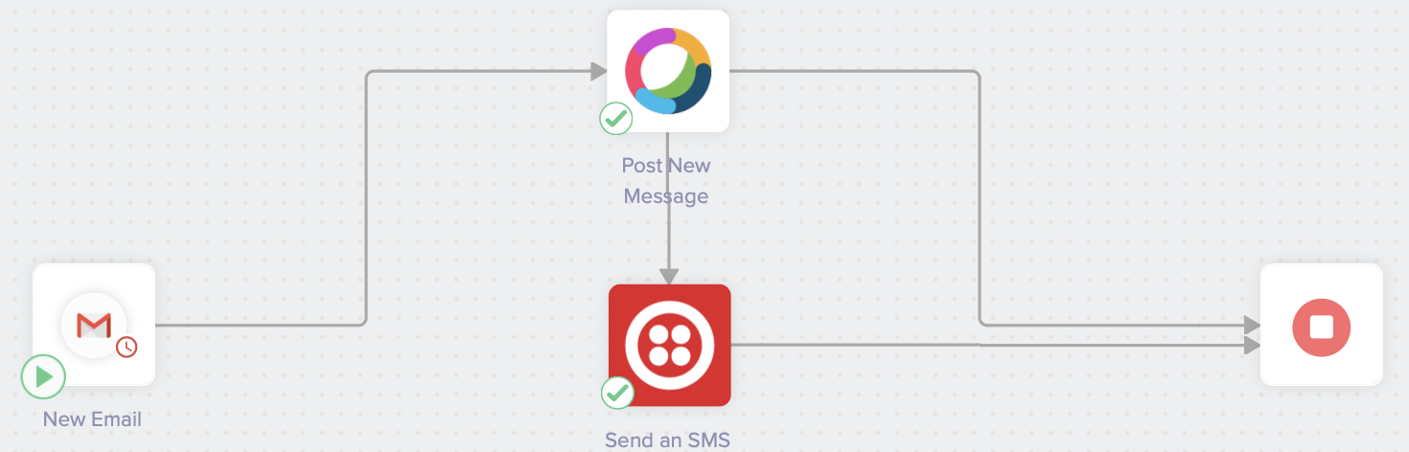
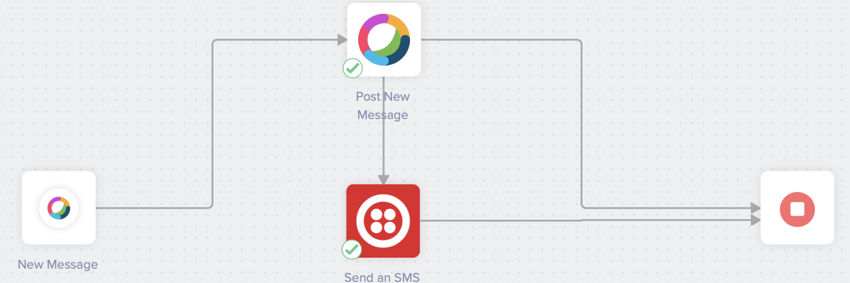
Workflows
Cisco TAC
Foosball
Cisco TAC
Support APIs
WebEx Teams
TAC Connected Bot

